Slide 1

Predicting Churn in Streaming Platforms
Faraan Khan

Slide 2
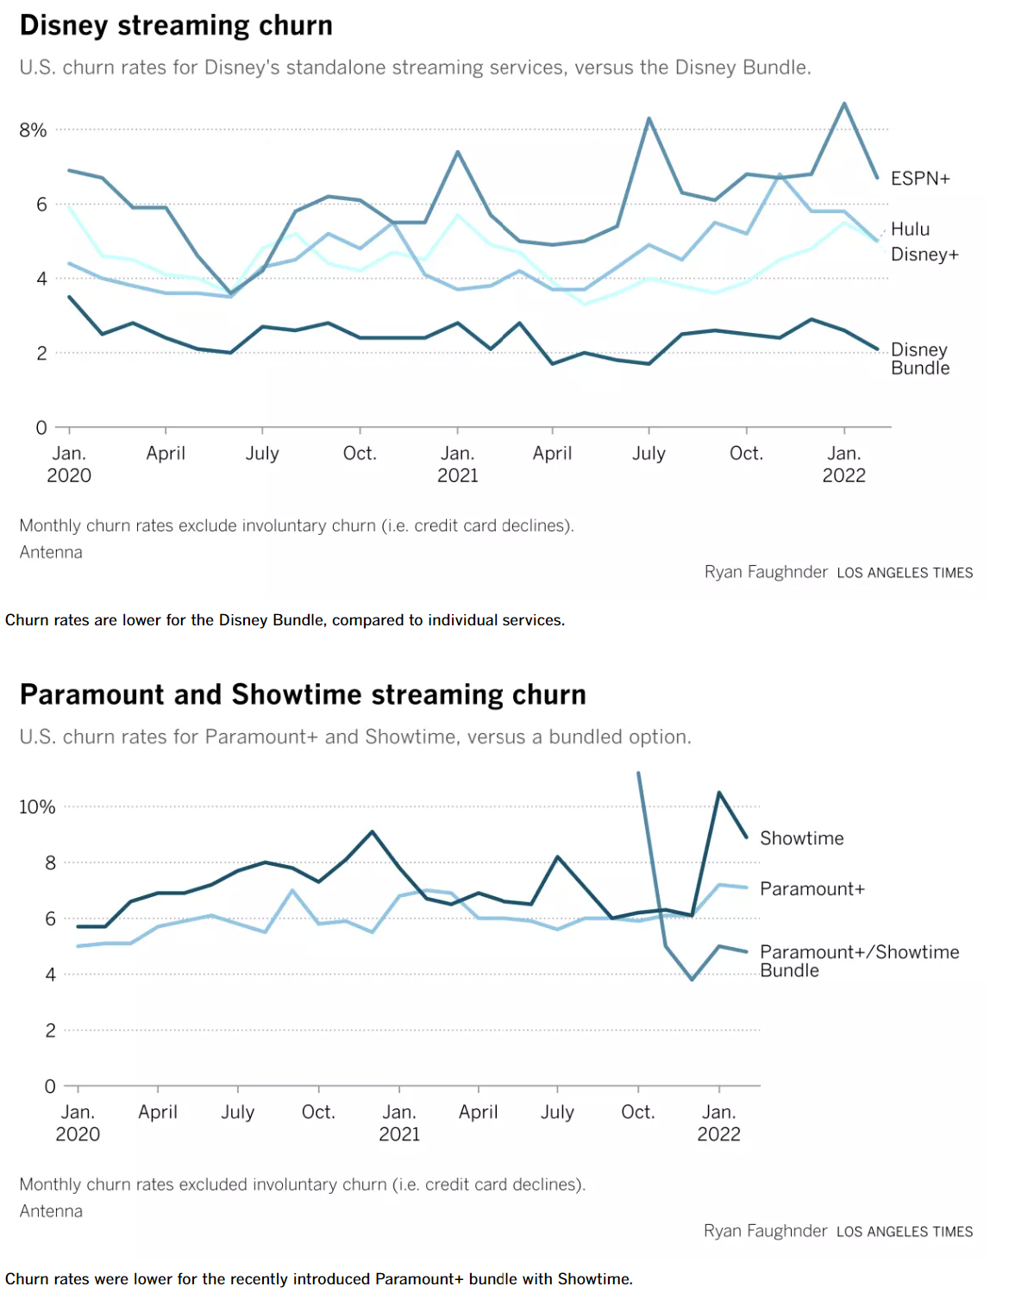
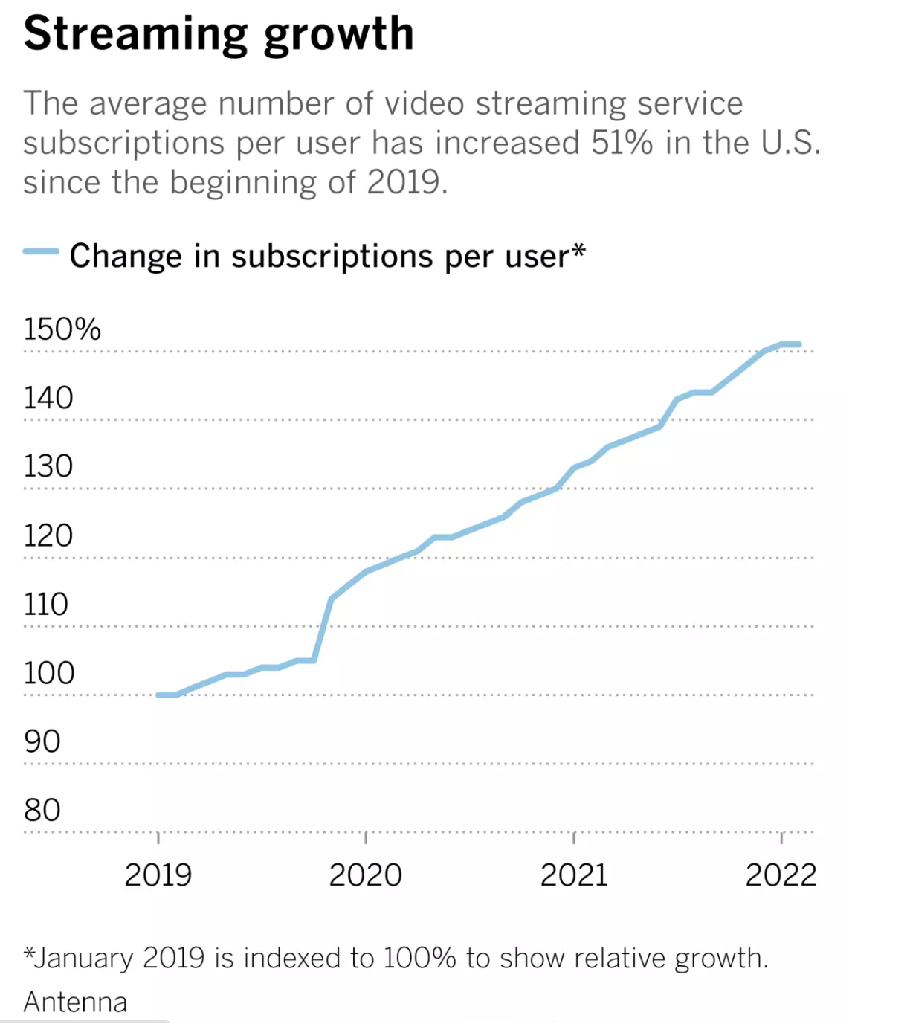
The State of the Industry
Although streaming services are experiencing growth, churn remains an important issue that companies seek to resolve*
*https://www.latimes.com/entertainment-arts/business/newsletter/2022-04-05/here-are-four-charts-that-explain-future-of-streaming-the-wide-shot

Slide 3
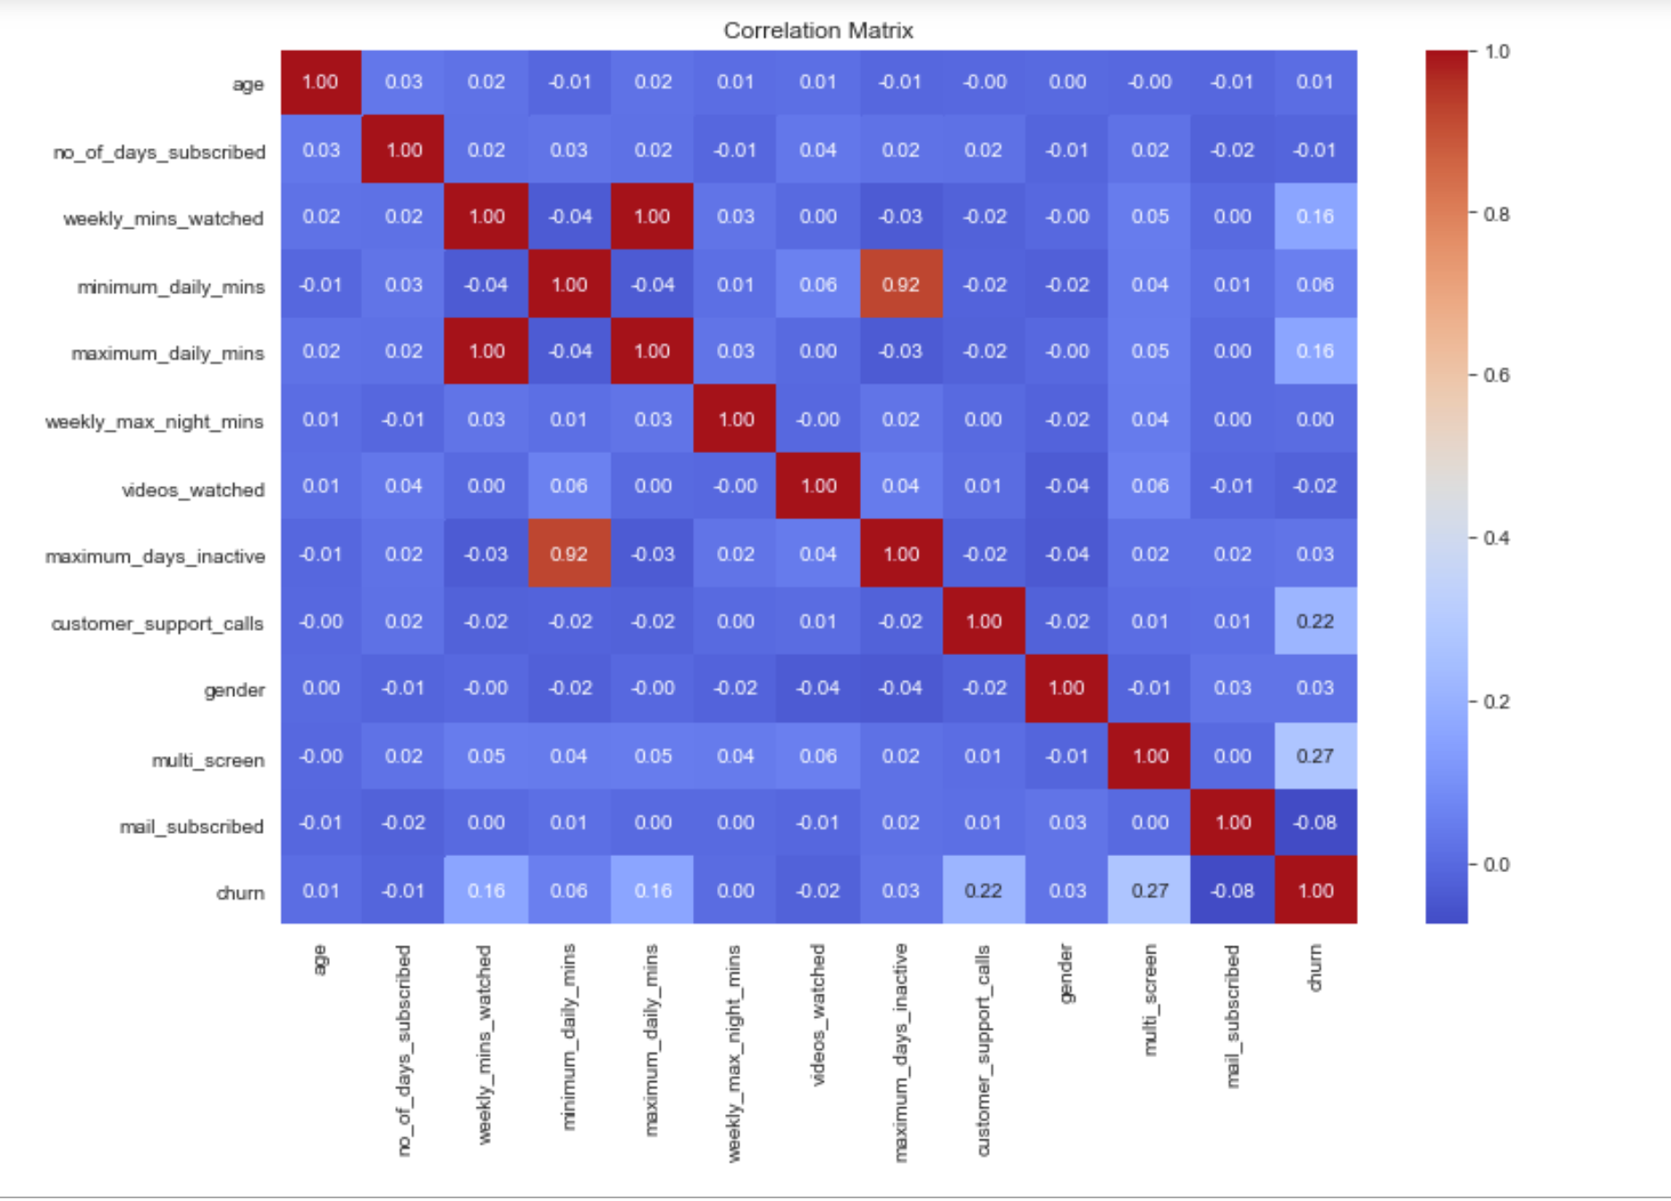
Objective and Data
Build a classification model that helps predict whether a user will churn or not
Dataset: Kaggle dataset “Churn Modeling for OTT Platforms”
After SMOTE and Feature Engineering, 2388 rows, 10 columns
Target Variable: Churn
Independent Variables:
Age
Number of Days Subscribed
Weekly Minutes Watched
Weekly Max Night Minutes
Videos Watched
Maximum Days Inactive
Customer Support Calls
Gender
Multi-Screen
Mail Subscribed
Optimize Model for Recall – minimize false negatives
Baseline counts: 87% no churn, 13% churn

Slide 4
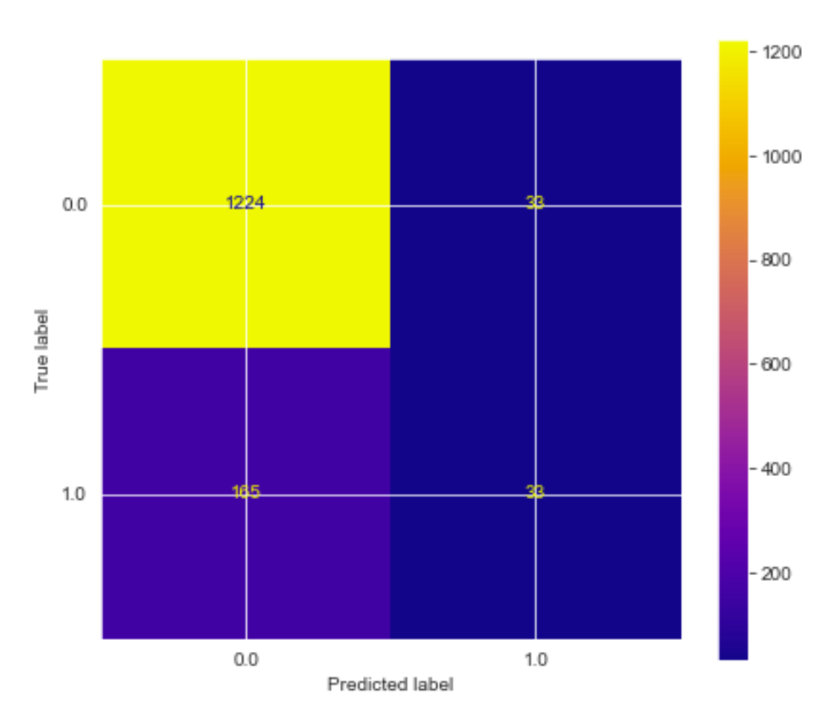
Baseline Logistic Regression
Accuracy: .86
Precision: .39
Recall: .18
F1- Score: .24
Model performs poorly for accuracy; almost worse than the baseline when picked at random

Slide 5
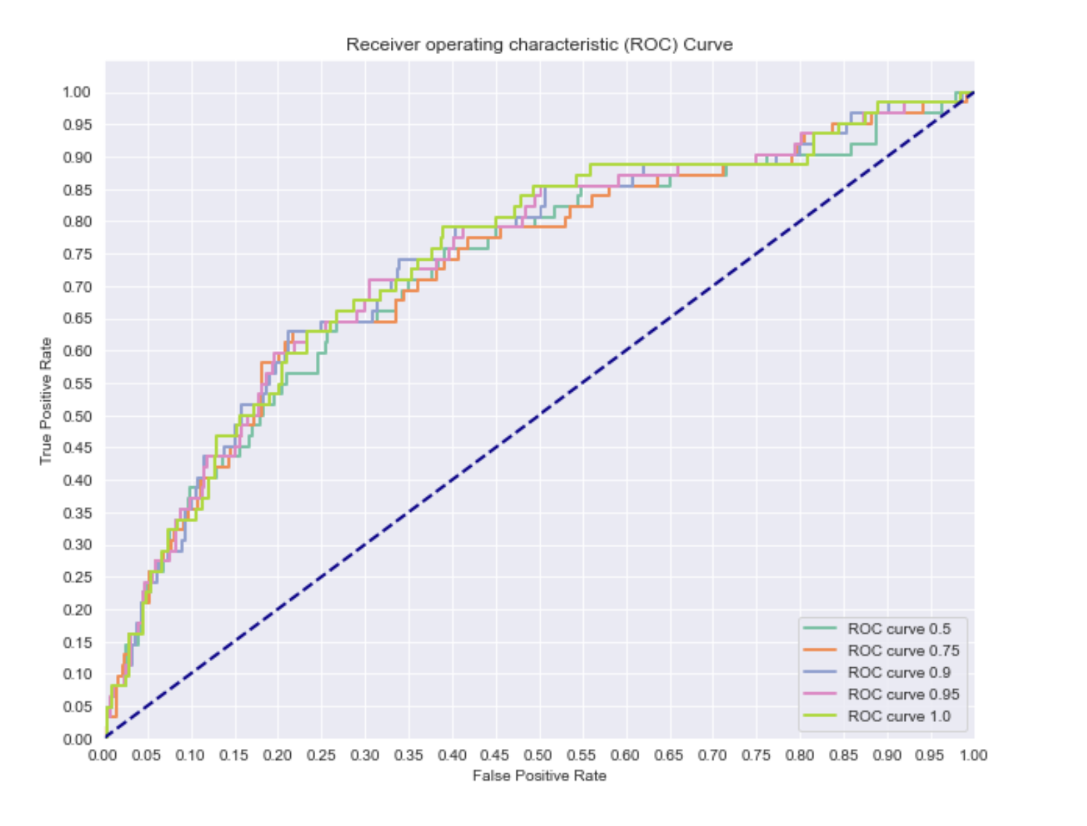
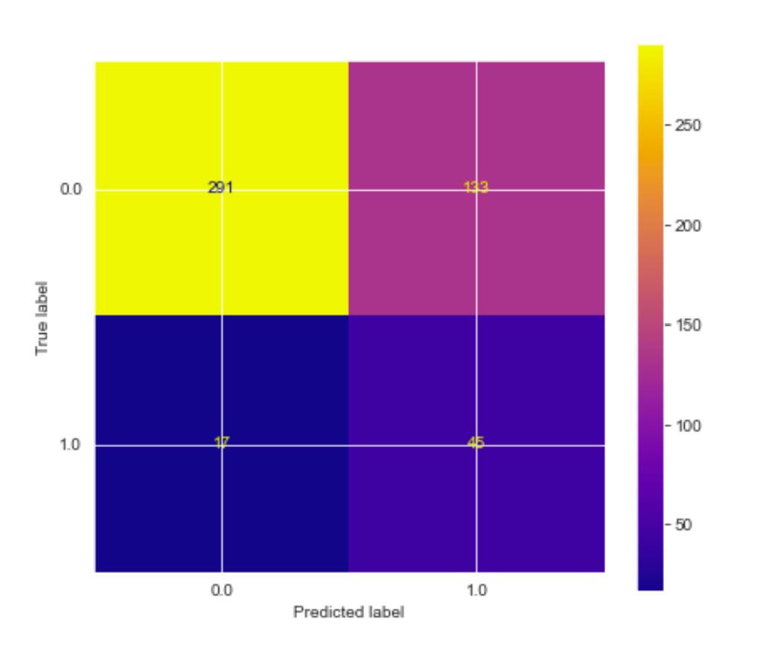
Model Performance post SMOTE
Sampling Strategy Ratio of .9 selected:
Accuracy: 0.69
Precision: 0.25
Recall: 0.72
f1 Score: 0.38
Recall and f1 scores dramatically improve

Slide 6
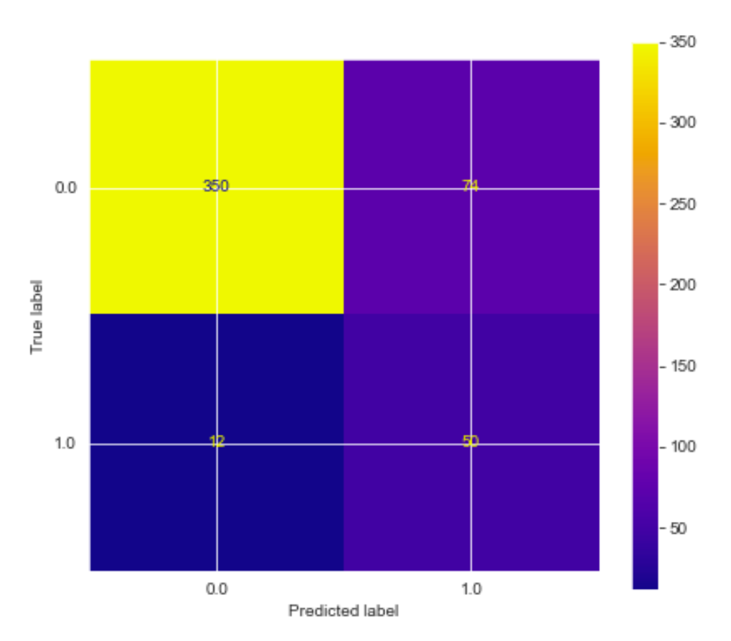
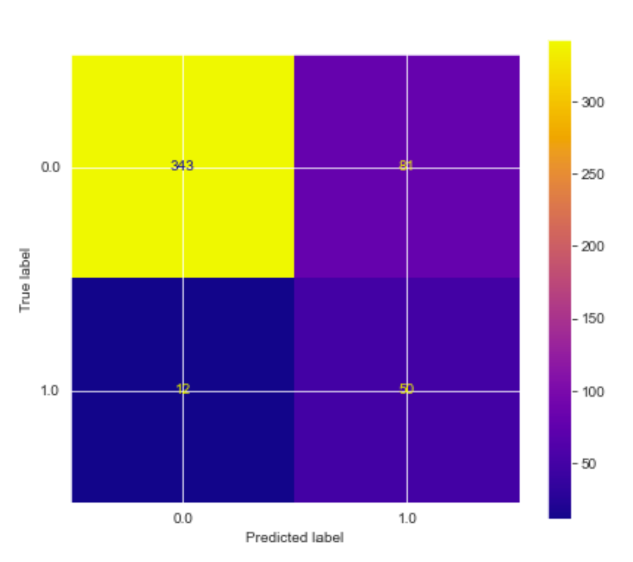
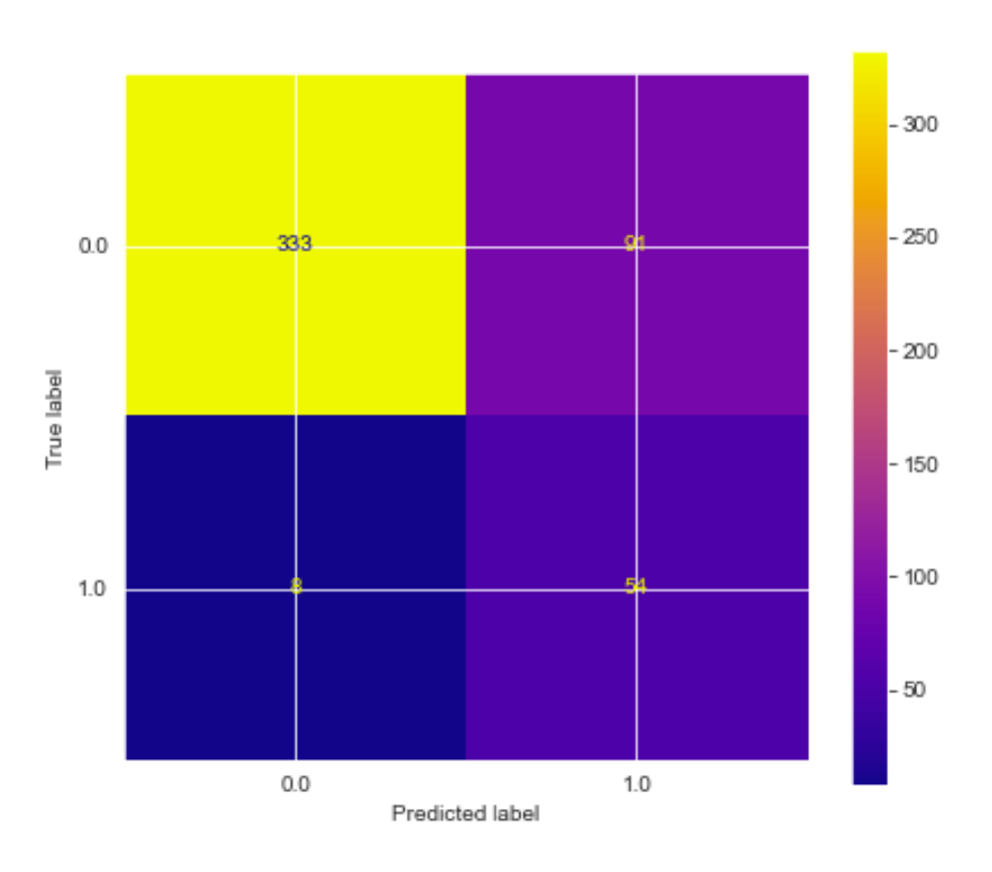
Model Performance After Polynomial Transformation
Polynomial Degree 4:
Accuracy: 0.82305
Precision: 0.40323
Recall: 0.80645
F1 Score: 0.53763
Polynomial Degree 3:
Accuracy: 0.80864
Precision: 0.38168
Recall: 0.80645
F1 Score: 0.51813
Polynomial Degree 2:
Accuracy: 0.79630
Precision: 0.37241
Recall: 0.87097
F1 Score: 0.52174

Slide 7
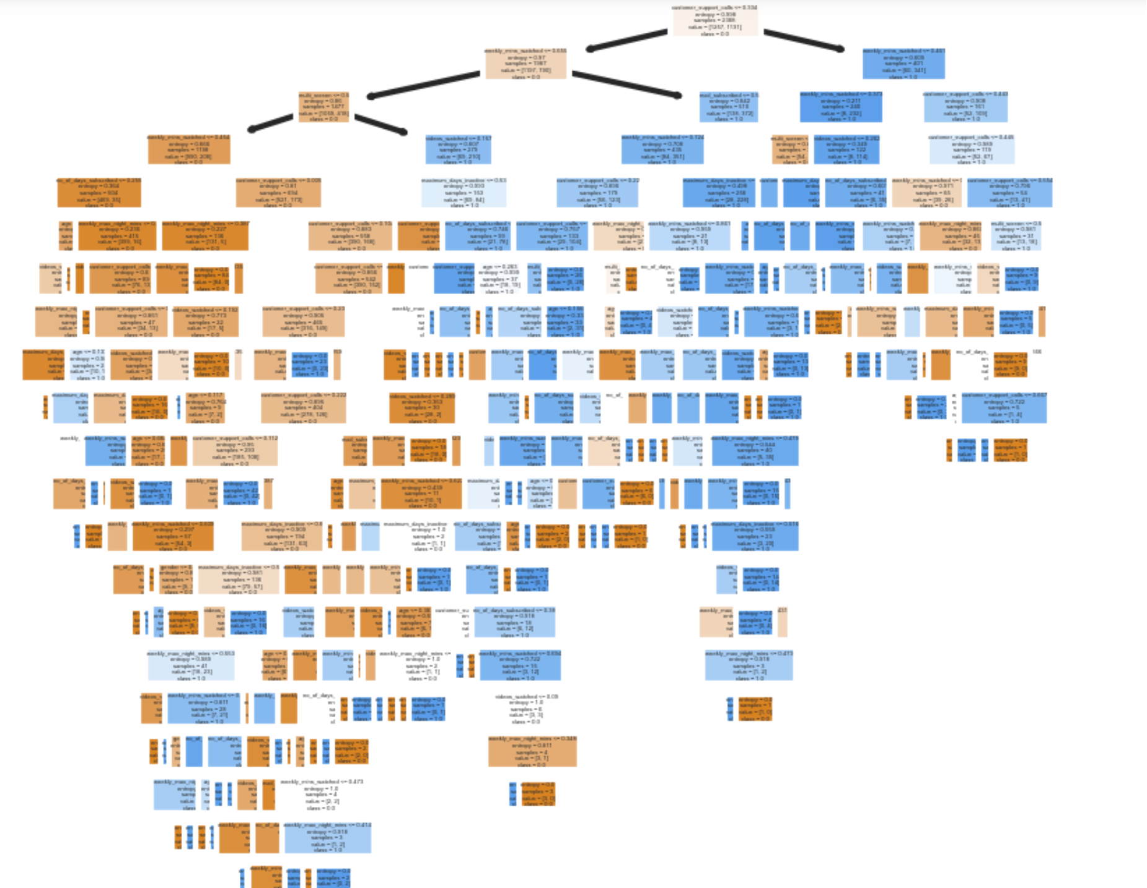
Decision Tree Baseline
Very clearly overfitted:
Accuracy: 0.5
Precision: 0.18
Recall: 0.82
F1 Score: 0.30
ROC AUC: 0.64

Slide 8
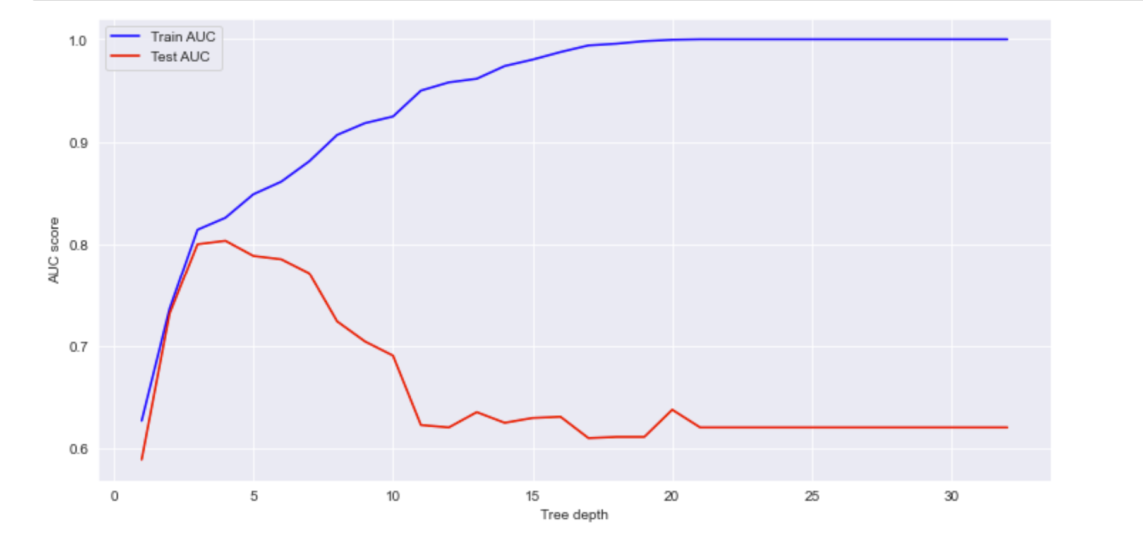
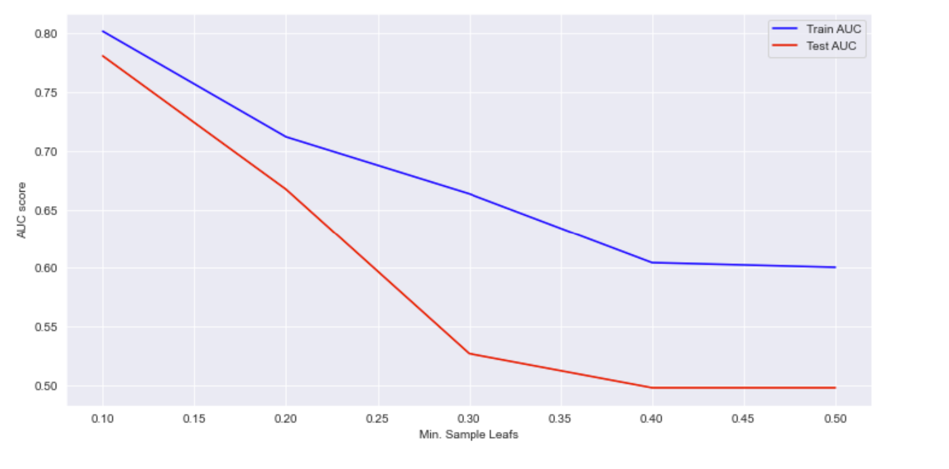
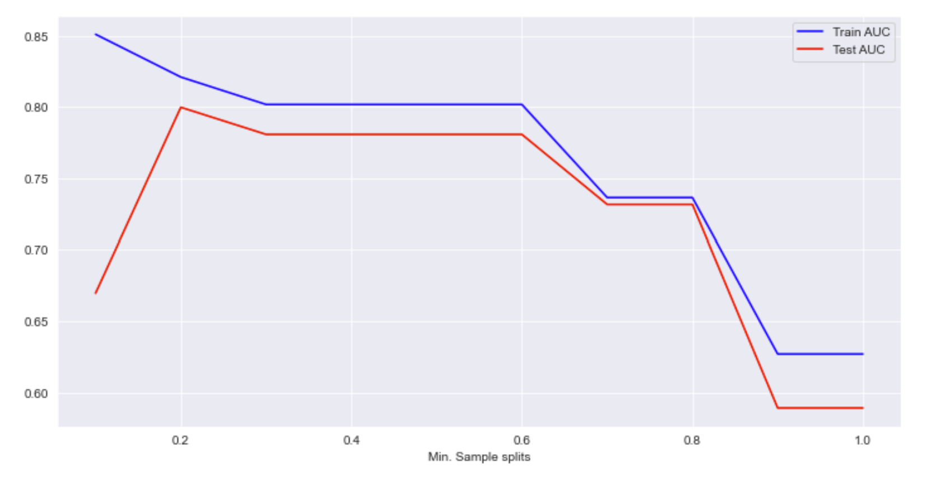
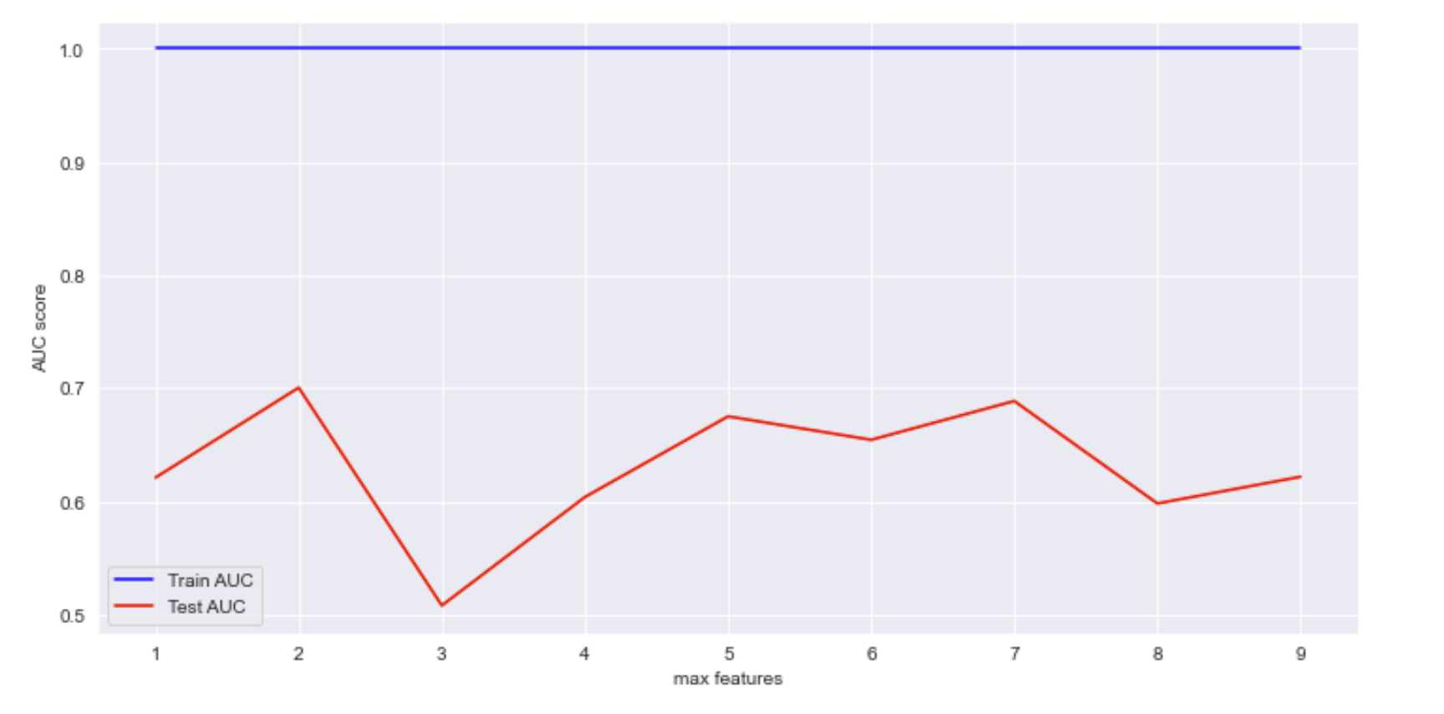
Finetuning Hyperparameters

Slide 9
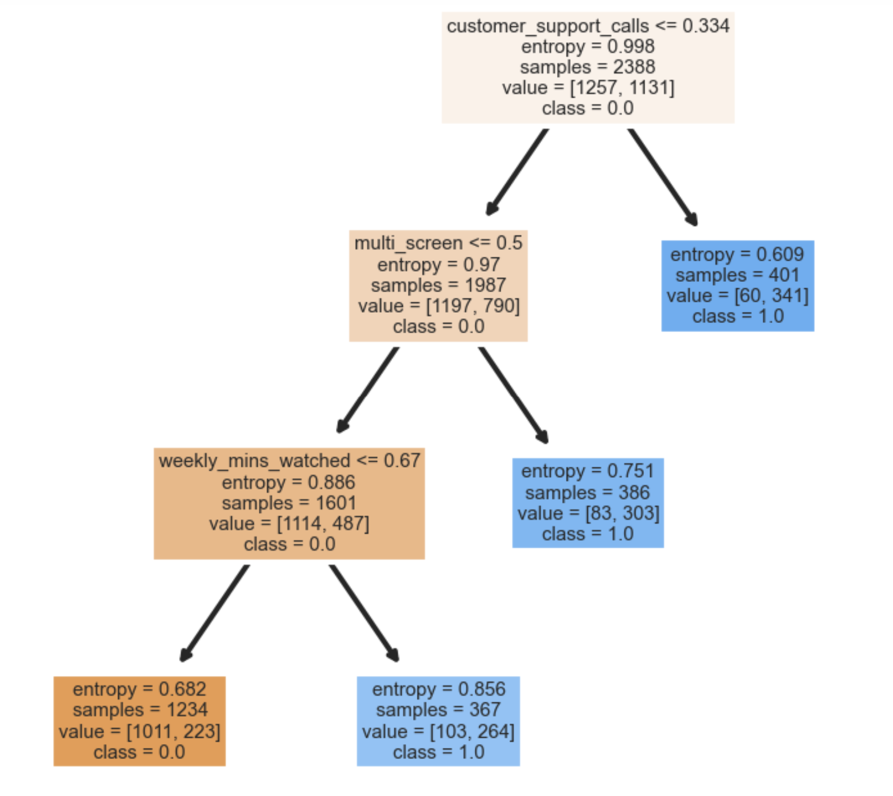
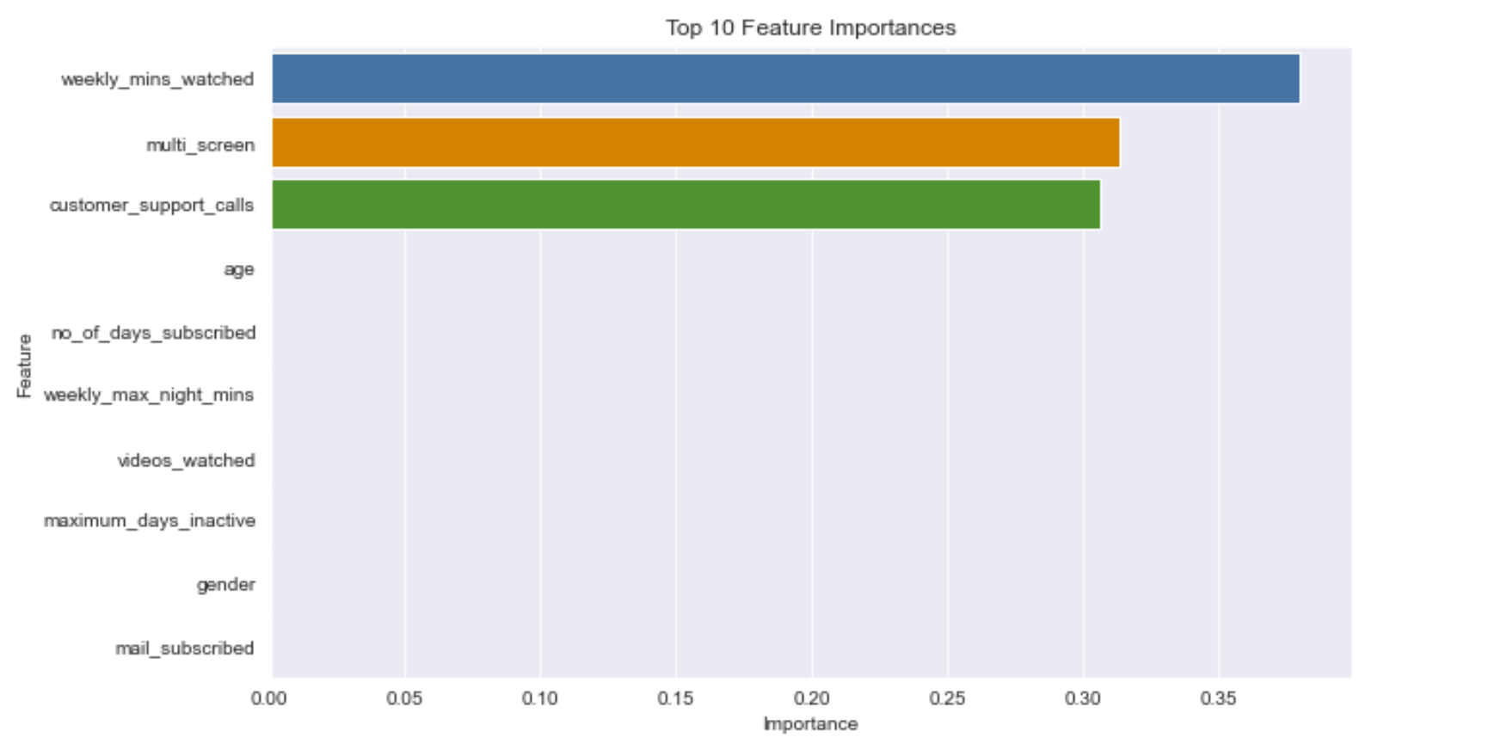
Optimized Decision Tree
Performance Metrics for pruned and hyper tuned tree:
Accuracy: 0.71
Precision: 0.29
Recall: 0.89
F1 Score: 0.44
ROC AUC: 0.79

Slide 10
Recommendations and Next Steps
Of the two models (optimized logistic regression and decision tree), the decision tree yielded the higher recall score
The most important features in predicting churn: weekly minutes watched, multi-screen, customer support calls
Incentivize customers to download the app on multiple devices (exclusive bonus content only accessible using the app)
In the long run, approach other companies for partnerships that bundle content and cost
Begin A/B testing features like customer support bots to reduce the number of support calls made
Identify high risk customers as those approaching the critical support call volume when probability of churn increases and assign a special support member to resolve issues

Slide 11
Questions?

